Slide 3
Karen Danielyan
Senior DevOps Engineer at DataArt Armenia
Systems/DevOps Engineer with 14+ years of experience in Software development and Systems/Network Administration. Experienced with Software Development Lifecycle and Agile methodologies such as Scrum. Also, I have team management experience in Systems and Software Engineering.

Slide 4
Agenda
What is Ansible Galaxy
How to create Ansible Roles
Where to store Ansible Roles
Role installation and dependencies

Slide 5
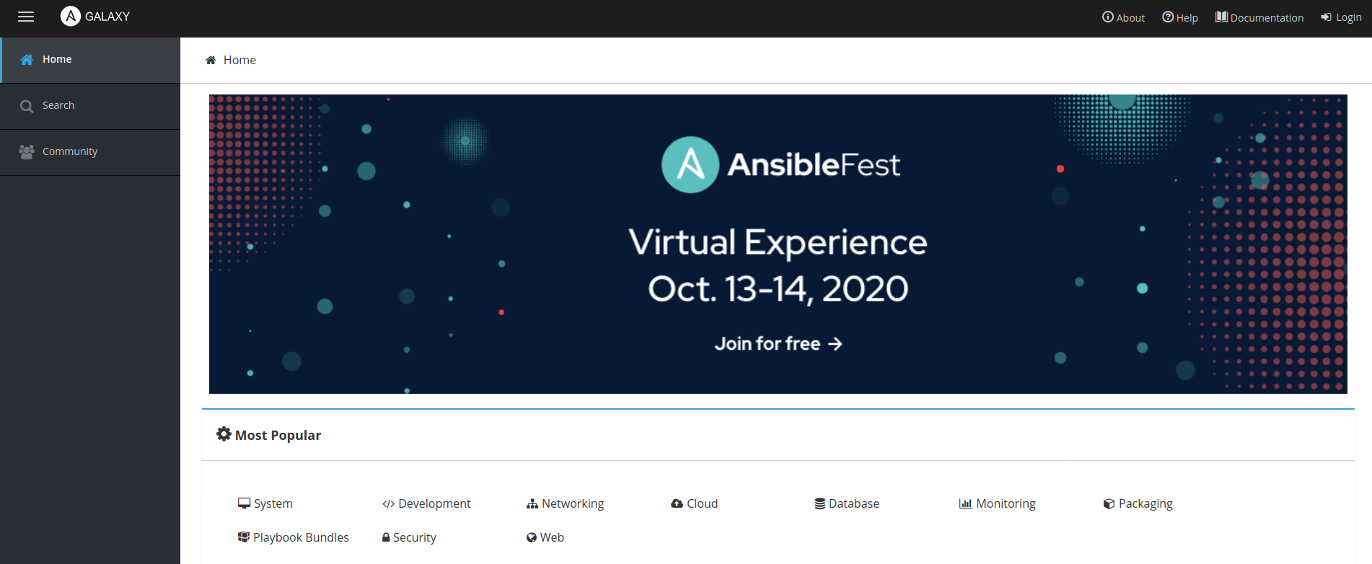
What is Ansible Galaxy
galaxy.ansible.com
Galaxy is a hub for finding and sharing Ansible content.
https://galaxy.ansible.com

Slide 6
How to create Ansible Roles
Directory Layout
Manually
ansible-galaxy init <ROLE_NAME>
ansible-development-kit
├── defaults
│ └── main.yml
├── files
├── handlers
│ └── main.yml
├── LICENSE
├── meta
│ └── main.yml
├── README.md
├── requirements.yml
├── tasks
│ └── main.yml
├── templates
└── vars
└── main.yml
https://galaxy.ansible.com/docs/contributing/creating_role.html https://github.com/lean-delivery/ansible-development-kit

Slide 7
Where to store Ansible Roles
Why GIT?
Version control
Distributed development
Simplify work review process
Simplify dependency management

Slide 8
Role separation
Simplify work process among developers.
Simplify work review process
Simplify dependency management

Slide 9
Role installation and dependencies
If your role or playbook depends on other role, the best practice is to add 'dependencies: ' section in /meta/main.yml and in /requirements.yml files.
For Role: /meta/main.yml
For PlayBook: /requirements.yml
# from Galaxy
- src: geerlingguy.docker
# from GitHub
- src: https://github.com/Thalamus-am/ansible-role-user-config
# from Galaxy
- src: geerlingguy.docker
# from GitHub
- src: https://github.com/Thalamus-am/ansible-role-user-config
https://docs.ansible.com/ansible/latest/user_guide/playbooks_reuse_roles.html

Slide 10
Role installation and dependencies
# Public role from galaxy:
ansible-galaxy install geerlingguy.apache
# Private role from git over https. ssh is also acceptable here:
ansible-galaxy install git+https://github.com/geerlingguy/ansible-role-apache.git
# From requirements file:
ansible-galaxy install -r requirements.yml

Slide 11
Role installation and dependencies
Option 1
----------------
PLAYBOOK:
- hosts: <TARGET_HOST>
remote_user: <ANSIBLE USER>
become: true
# Install Galaxy roles
pre_tasks:
- name: Install galaxy roles
command: ansible-galaxy install -r ./requirements.yml
become: no
delegate_to: localhost
tasks:
- include_role:
name: ansible-role-docker-container
Option 2
----------------
SHELL:
ansible-galaxy install -r requirements.yml
PLAYBOOK:
- hosts: <TARGET_HOST>
remote_user: <ANSIBLE USER>
become: true
roles:
- ansible-role-docker-container

Slide 12
Role installation and dependencies
A
tasks:
- include_role:
name: ansible-role-A
roles:
- ansible-role-A
B
C
D
C
B
D
C
A
C
D
D
C
B
A
D

Slide 13
Naming conventions
All variables for each role should have a unique prefix or acronym as a prefix.
ansible-role-docker-container
docker_container_instance_name: nginx
docker_container_app_name: nginx
docker_container_image_version: latest
docker_container_docker_image: "{{ docker_container_app_name }}:{{ docker_container_image_version }}"
docker_container_volume_name: "{{ docker_container_instance_name }}-volume"
ansible-role-user-config
user_config_instance_name: apache
user_config_group_name: devops
user_config_user_defaults: true
user_config_default_ssh_users: kdan

Slide 14
Thank you!

